Slide 1
SmartShop Mobile App
A Flutter & Firebase eCommerce Solution

Slide 2
Introduction
•
What is SmartShop?
A modern, cross-platform eCommerce mobile application built for a seamless user experience.
•
Purpose of the App
To provide a fast, responsive, and user-friendly shopping platform, from browsing to checkout.
•
Target Users
Tech-savvy online shoppers, mobile-first consumers, and anyone seeking a convenient and reliable way to shop.

Slide 3






Problem Statement
Common Issues
Why They Exist
The Gap We Fill
Users face clunky UIs, slow performance, and complicated checkout processes in many existing online shopping apps.
These problems come from outdated architectures, inefficient backends, and unoptimized data handling.
SmartShop delivers a fast, scalable, and smooth shopping experience built with modern Flutter design and performance in mind.

Slide 4
Solution Overview
Our Approach
•
A single Flutter app provides a smooth, native-like feel on all devices.
•
Main User Flow: Browse Products -> Add to Cart -> Simple Checkout -> Order Confirmed.
•
Overall Value: A fast, reliable, and enjoyable shopping journey from start to finish.

Slide 5
Tech Stack
•
Frontend: Developed with Flutter for a smooth, responsive, and cross-platform experience on iOS and Android. Designed with user-friendly and visually appealing interfaces.
•
Backend: Powered by Firebase, providing secure and scalable services like Authentication, Firestore, Storage, and real-time notifications. Ensures fast and reliable data management.
•
State Management: Provider is used to manage the app’s state efficiently, separating logic from UI for clean, maintainable, and scalable code.
•
Tools:
Android Studio : main development environment
Git & GitHub : version control and collaborative development
Flutter Packages : to integrate features like animations, image handling, and network management quickly and reliably

Slide 6
Core Features
User Authentication: Secure login and registration with Email/Password and Google Sign-In.
Browse Products: A clean, scrollable list of all available products with filtering (if implemented).
Product Details: View detailed information, including multiple images, price, and description.
Add to Cart: Seamlessly add products to the user's personal shopping cart.
Cart Management: Ability to update item quantities or remove items directly from the cart.
Checkout: A simple, multi-step process to confirm the order and shipping details.
User Profile & Order History: View personal details and a list of all past orders.

Slide 7
App Architecture
•
Clean Folder Structure: Organized by feature (e.g., auth, products, cart) for scalability and maintenance.
•
Separation of Concerns: Clear division between UI (Widgets), Logic (Provider), and Data (Services).
•
Firebase Integration: Firebase services are encapsulated in a dedicated repository or service class.
•
State Management: Provider is used to manage app state efficiently, passing data only to widgets that need it.

Slide 8
Team Contributions
Team Member | Primary Responsibility
Ahmed Nour | Team Leader & backend setup
Omar Mahmoud | Home / Auth Screens & presentation
Osama Bhaa | Profile screen & Reusable Components
Mohamed Osama | Documentation & Cart/Auth Screens
Mohamed Hatem | Theming & UI
Zakarya Hamdy | Widgets & Testing

Slide 9
Testing: Example Test Cases
Feature | Test Case / Action | Expected Result | Status
Authentication | Login with invalid password | Error message "Invalid credentials" is shown | Pass
Product | Tap on a product from home screen | Navigate to Product Details screen for that item | Pass
Cart | Click "Add to Cart" on detail screen | Cart icon badge increments by 1 | Pass
Cart | Remove item from cart | Item is removed and cart total recalculates | Pass
Checkout | Complete checkout flow | Order appears in "Order History" | Pass

Slide 10






Documentation
Project & Firebase
GitHub README.md
User Manual
Detailed docs on project scope, goals, and the Firebase Firestore schema design and storage rules.
A simple guide that explains the core features and user flows from a customer's perspective.
A comprehensive README with full setup, installation, and dependency instructions to run the app locally.

Slide 11
Demo Flow
Setup Instructions
Live Test Scenarios
1.
git clone [repository-url]
▪
User Login / Registration
2.
flutter pub get
▪
Browse Product List & View Details
3.
Run on emulator or real device.
▪
Add Item to Cart
▪
Proceed to Checkout & Confirm
▪
View Profile & Order History

Slide 12
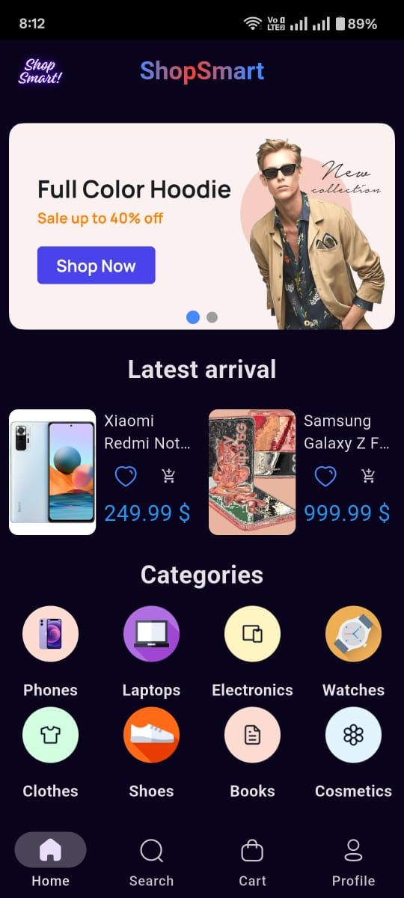
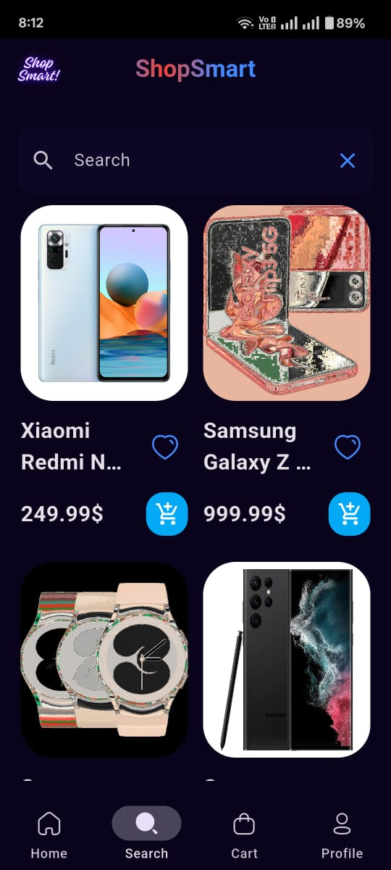
UI

Slide 13
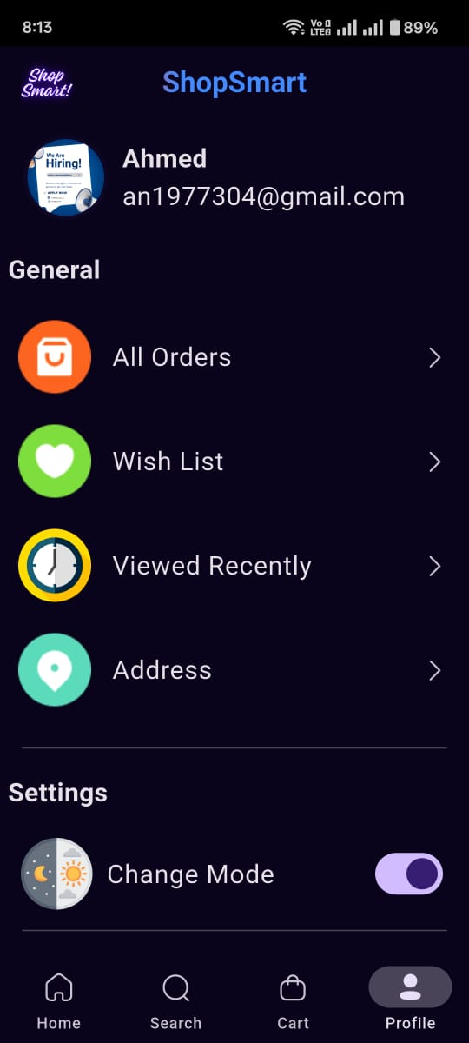
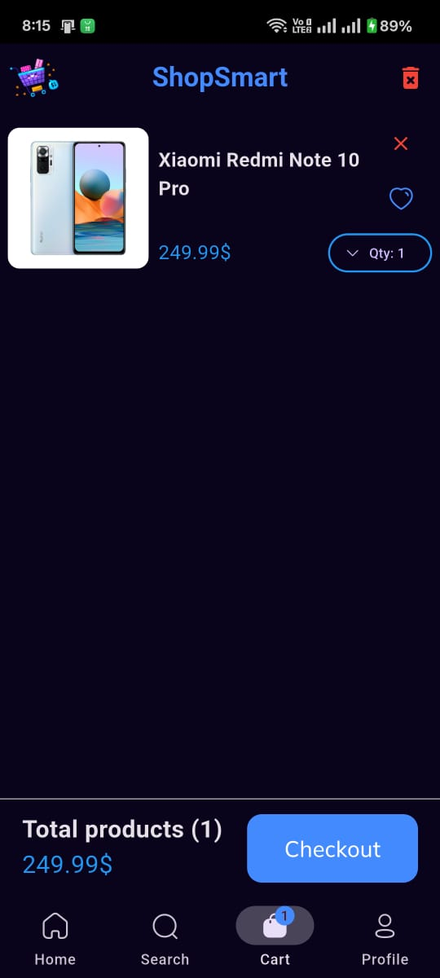
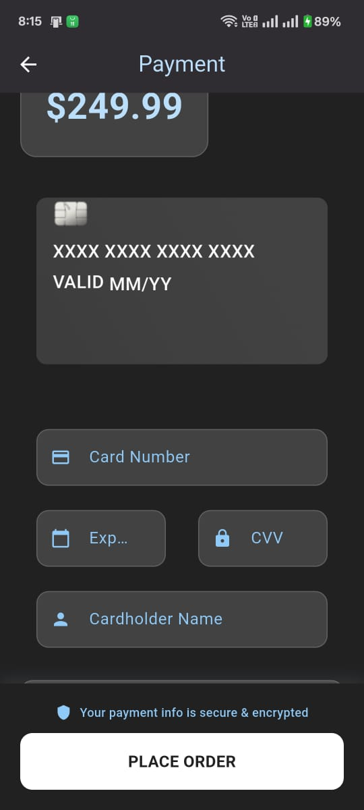
UI

Slide 14
Thank You
Questions?

